Slide 1

CS 2300 – Exam 2 Review
Notes:
Created by Educational Technology Network. www.edtechnetwork.com 2009

Slide 2
POWERPOINT JEOPARDY
Proofs
Sets
Functions and Sequences
Divisibility and Modular
Primes and Bases
100
100
100
100
100
200
200
200
200
200
300
300
300
300
300
400
400
400
400
400
500
500
500
500
500

Slide 3
Proofs – 100:
(1.7 – Exercise 6)
Prove that the product of two odd numbers is odd.

Slide 4
Answer – 100:

Slide 5
Proofs – 200:
(1.7 – Exercise 26)
Prove that if n is a positive integer, then n is even if and only if 7n + 4 is even.

Slide 6
Answer – 200:

Slide 7
Proofs – 300:
(4.1 – Exercise 6)
Prove that if a, b, c, and d are integers, where a ≠ 0, such that a | c and b | d, then ab | cd

Slide 8
Answer – 300:

Slide 9
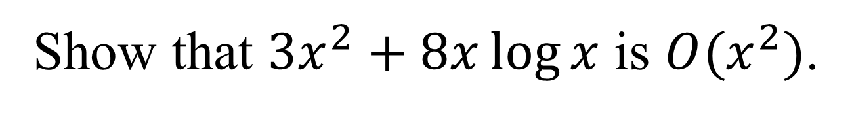
Proofs – 400:
(3.2 – Example 12)
Show that $3x^{2}+8x\log{x}$ is $O(x^{2})$.

Slide 10
Answer – 400:

Slide 11
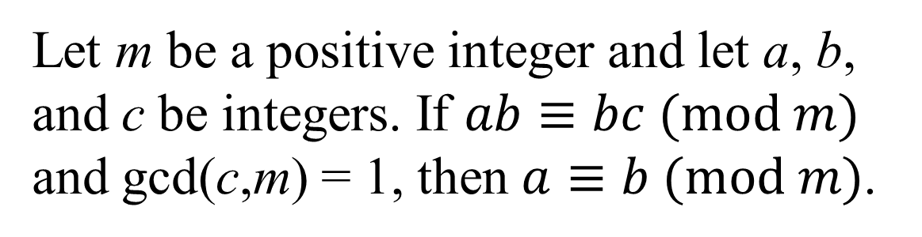
Proofs – 500:
(4.3 – Theorem 7)
Let m be a positive integer and let a, b, and c be integers. If $ab≡bc (mod m)$ and gcd(c,m) = 1, then $a≡b (mod m)$.

Slide 12
Answer – 500:

Slide 13
Sets – 100:
(2.2 – Exercise 3)
Let A = {1,2,3,4,5} and B = {0,3,6}. Find
a) A U B
b) A ∩ B
c) A – B
d) B – A

Slide 14
Answer – 100:
a) A U B = {0,1,2,3,4,5,6}
b) A ∩ B = {3}
c) A – B = {1,2,4,5}
d) B – A = {0,6}

Slide 15
Sets – 200:
(2.1 – Exercise 10)
Determine whether these statements are true or false.
a) ∅ ∈ {∅}
b) ∅ ∈ {∅, {∅}}
c) {∅} ∈ {∅}
e) {∅} ⊂ {∅, {∅}}
f ) {{∅}} ⊂ {∅, {∅}}

Slide 16
Answer – 200:
a) T
b) T
c) F
e) T
f ) T

Slide 17
Sets – 300:
(2.2 – Exercise 14)
Find the sets A and B if A − B = {1, 5, 7, 8},
B − A = {2, 10}, and A ∩ B = {3, 6, 9}.

Slide 18
Answer – 300:
A = {1,3,5,6,7,8,9}
B = {2,3,6,9,10}

Slide 19
Sets – 400:
(Power Sets)
What is the Power set of A = {2,f,m}?
P(A) =

Slide 20
Answer – 400:
P(A) = {∅,{2}, {f}, {m}, {2,f}, {2,m}, {f,m}, {2,f,m}}

Slide 21
Sets – 500:
(2.1 – Exercise 32a)
Let A = {a, b, c}, B = {x, y}, and C = {0, 1}.
Find A × B × C.

Slide 22
Answer – 500:
A × B × C = { (a,x,0), (b,x,0),(c,x,0),
(a,y,0),(b,y,0),(c,y,0),
(a,x,1), (b,x,1),(c,x,1),
(a,y,1),(b,y,1),(c,y,1) }

Slide 23
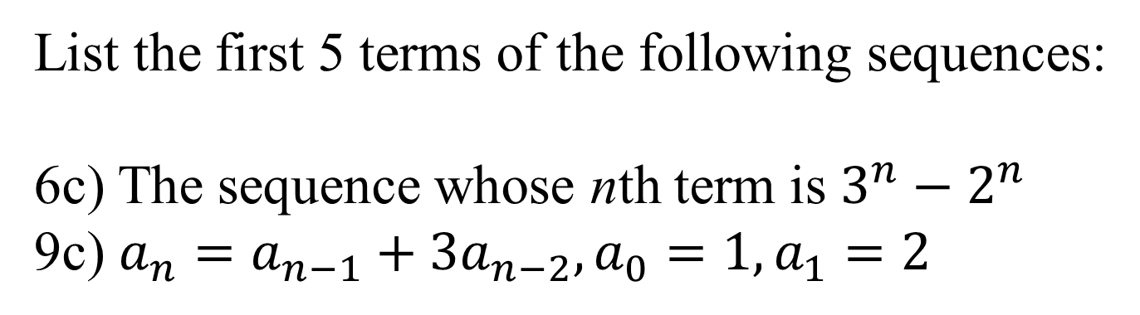
Functions – 100:
(2.4 – Exercises 6c, 9c)
List the first 5 terms of the following sequences:
6c) The sequence whose nth term is $3^{n}−2^{n}$
9c) $a_{n}=a_{n−1}+3a_{n−2}, a_{0}=1, a_{1}=2$

Slide 24
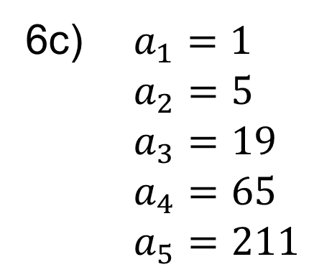
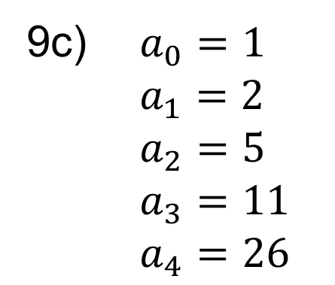
Answer – 100:
6c) $a_{1}=1$ $a_{2}=5$ $a_{3}=19$ $a_{4}=65$ $a_{5}=211$
9c) $a_{0}=1$ $a_{1}=2$ $a_{2}=5$ $a_{3}=11$ $a_{4}=26$

Slide 25
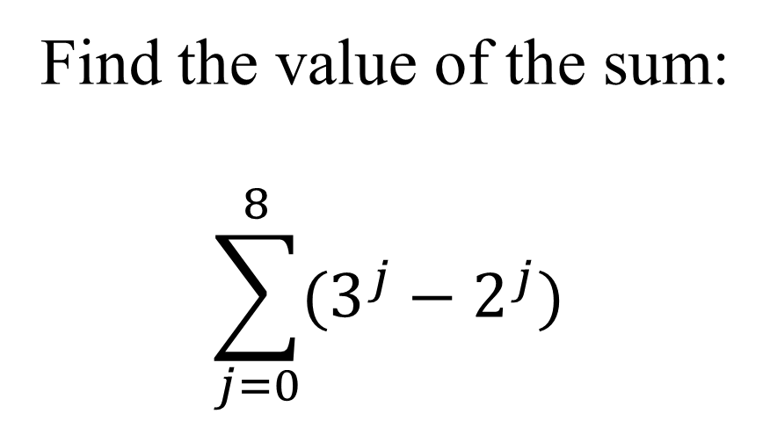
Functions – 200:
(2.4 - Exercise 32b)
Find the value of the sum:
$$\sum_{j=0}^{8}{(3^{j}−2^{j})}$$

Slide 26
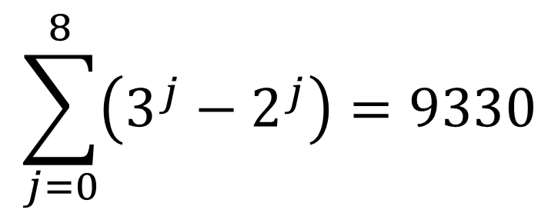
Answer – 200:
$$\sum_{j=0}^{8}{\left(3^{j}−2^{j}\right)}=9330$$

Slide 27
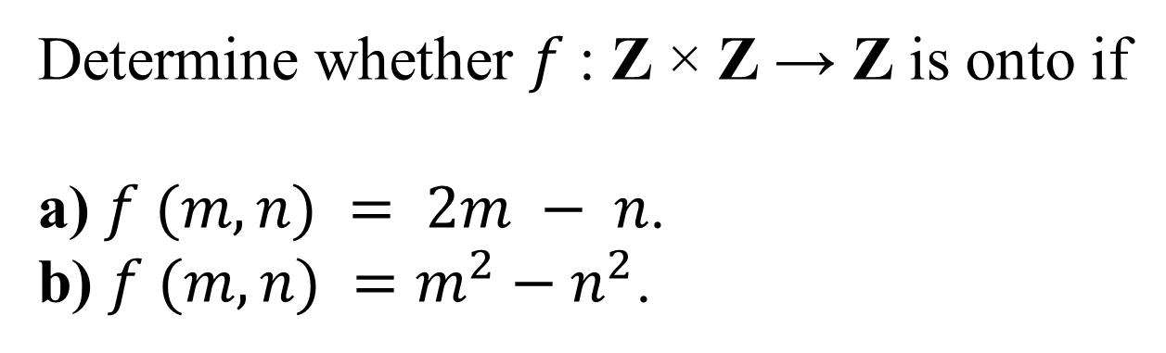
Functions – 300:
(2.3 - Exercise 14ab)
Determine whether $f$: Z × Z → Z is onto if
a) $f (m, n) = 2m − n$.
b) $f (m, n) =m^{2}−n^{2}$.

Slide 28
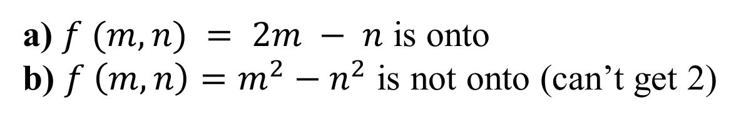
Answer – 300:
a) $f (m, n) = 2m − n$ is onto
b) $f \left(m, n\right)=m^{2}−n^{2}$ is not onto (can’t get 2)

Slide 29
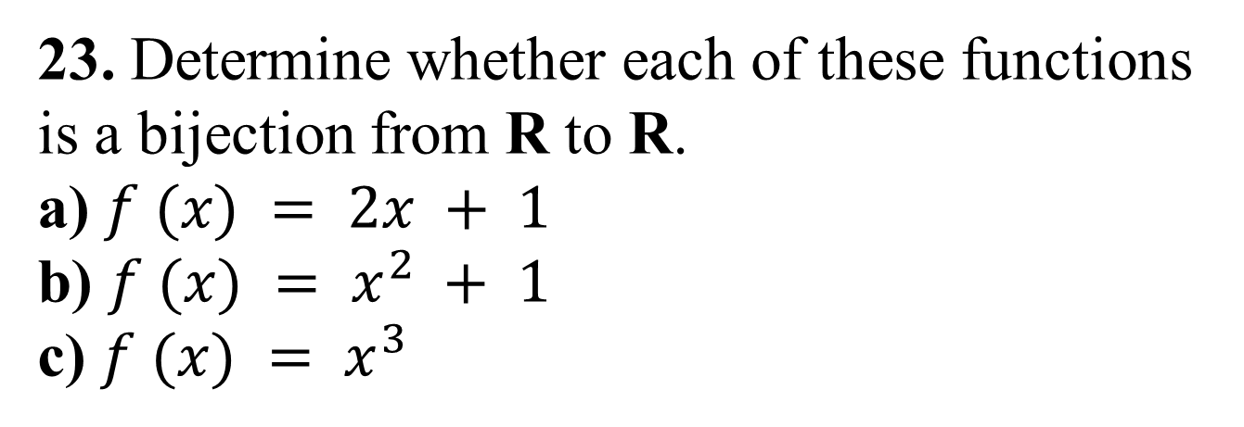
Functions – 400:
(2.3 - Exercise 23)
23. Determine whether each of these functions
is a bijection from R to R.
a) $f (x) = 2x + 1$
b) $f (x) = x^{2} + 1$
c) $f (x) = x^{3}$

Slide 30
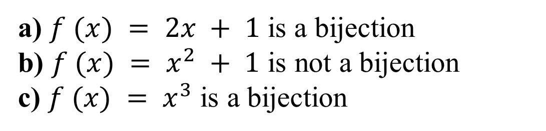
Answer – 400:
a) $f (x) = 2x + 1$ is a bijection
b) $f (x) = x^{2} + 1$ is not a bijection
c) $f (x) = x^{3}$ is a bijection

Slide 31
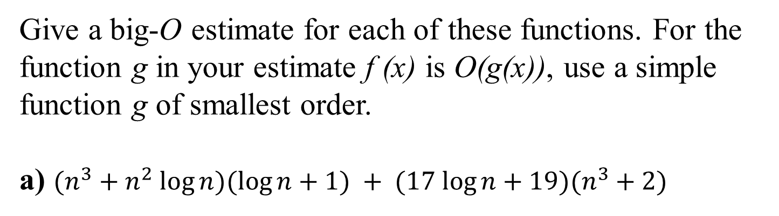
Functions – 500:
(3.2 - Exercise 26a)
Give a big-O estimate for each of these functions. For the
function g in your estimate f (x) is O(g(x)), use a simple
function g of smallest order.
a) $(n^{3}+n^{2} log⁡n)(log⁡n+1) + (17 log⁡n+19)(n^{3}+2)$

Slide 32
Answer – 500:

Slide 33
Divisibility – 100:
(4.1 - Exercise 23a)
Find a div m and a mod m when
a = 228, m = 119.

Slide 34
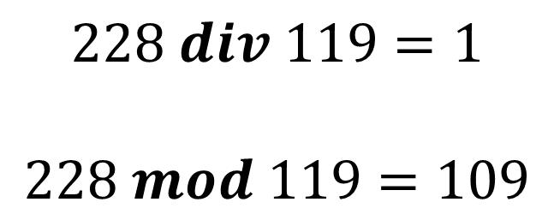
Answer – 100:
$$228 div 119=1$$
$$228 mod 119=109$$

Slide 35
Divisibility – 200:
(4.1 - Exercise 31)
Find each of these values.
a) (−133 mod 23 + 261 mod 23) mod 23
b) (457 mod 23 ・ 182 mod 23) mod 23

Slide 36
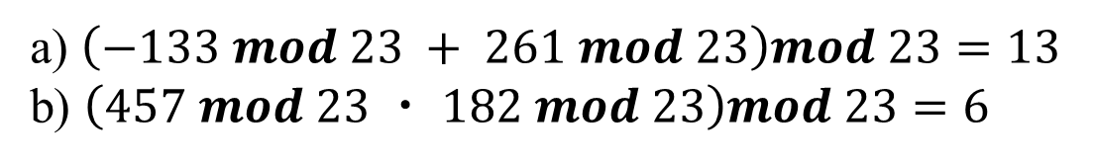
Answer – 200:
a) $\left(−133 mod 23 + 261 mod 23\right)mod 23=13$
b) $\left(457 mod 23 ・ 182 mod 23\right)mod 23=6$

Slide 37
Divisibility – 300:
(4.1 - Exercise 11)
What time does a 12-hour clock read
a) 80 hours after it reads 11:00?
b) 40 hours before it reads 12:00?
c) 100 hours after it reads 6:00?

Slide 38
Answer – 300:
a) 7:00
b) 8:00
c) 10:00

Slide 39
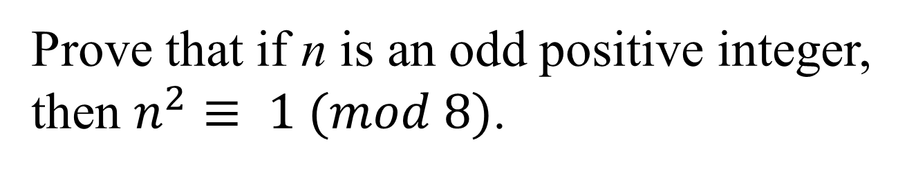
Divisibility – 400:
(4.1 - Exercise 40)
Prove that if n is an odd positive integer,
then $n^{2}≡ 1 (mod 8)$.

Slide 40
Answer – 400:

Slide 41
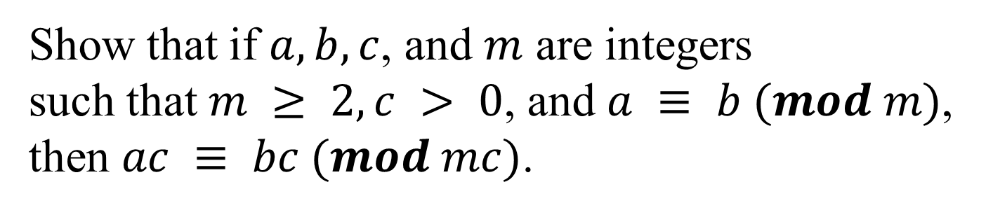
Divisibility – 500:
(4.1 – Exercise 36)
Show that if $a, b, c$, and $m$ are integers
such that $m ≥ 2, c > 0$, and $a ≡ b (mod m)$,
then $ac ≡ bc (mod mc)$.

Slide 42
Answer – 500:

Slide 43
Primes – 100:
(4.3 - Exercise 2)
Determine whether each of these integers is prime.
a) 19
b) 27
c) 93
d) 101
e) 107
f ) 113

Slide 44
Answer – 100:
a) Prime
b) Composite
c) Composite
d) Prime
e) Prime
f ) Prime

Slide 45
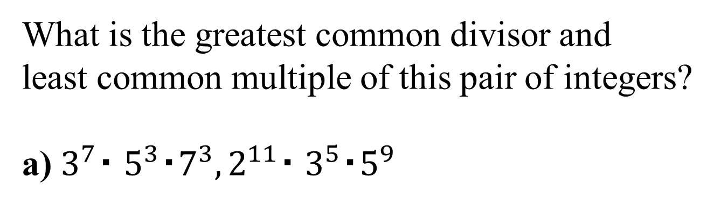
Primes – 200:
(4.3 - Exercise 25)
What is the greatest common divisor and
least common multiple of this pair of integers?
a) $3^{7}・ 5^{3}・7^{3}, 2^{11}・ 3^{5}・5^{9}$

Slide 46
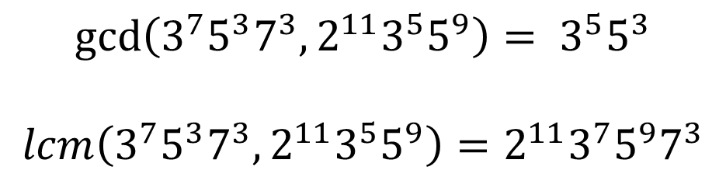
Answer – 200:
$$\gcd\left(3^{7}5^{3}7^{3},2^{11}3^{5}5^{9}\right)= 3^{5}5^{3}$$
$$lcm\left(3^{7}5^{3}7^{3},2^{11}3^{5}5^{9}\right)=2^{11}3^{7}5^{9}7^{3}$$

Slide 47
Primes – 300:
(4.3 - Exercise 15)
Which positive integers less than 30
are relatively prime to 30?

Slide 48
Answer – 300:
1, 7, 11, 13, 17, 19, 23, 29

Slide 49
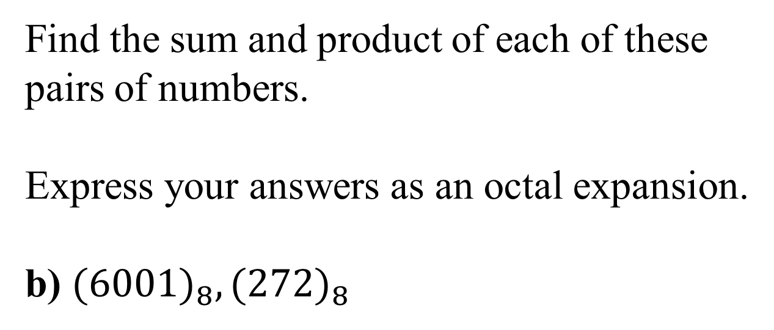
Primes – 400:
(4.2 – Exercise 23b)
Find the sum and product of each of these
pairs of numbers.
Express your answers as an octal expansion.
b) ${(6001)}_{8}, {(272)}_{8}$

Slide 50
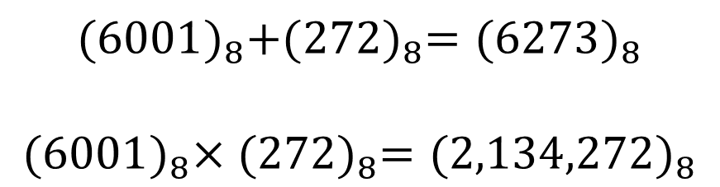
Answer – 400:
$${(6001)}_{8}+{(272)}_{8}={(6273)}_{8}$$
$${(6001)}_{8}×{(272)}_{8}={(2,134,272)}_{8}$$

Slide 51
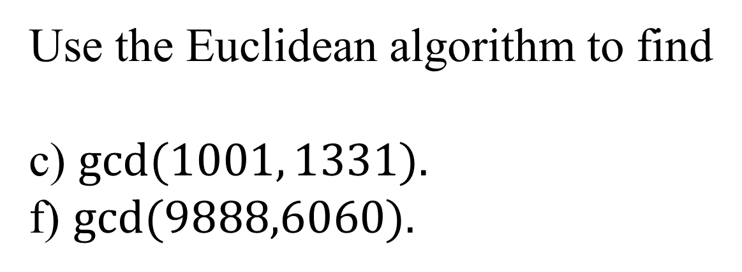
Primes – 500:
(4.3 - Exercise 33cf)
Use the Euclidean algorithm to find
c) $gcd⁡(1001, 1331).$
f) $gcd⁡(9888,6060).$

Slide 52
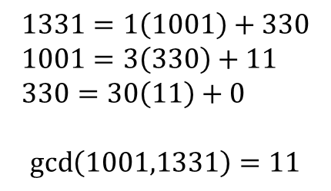
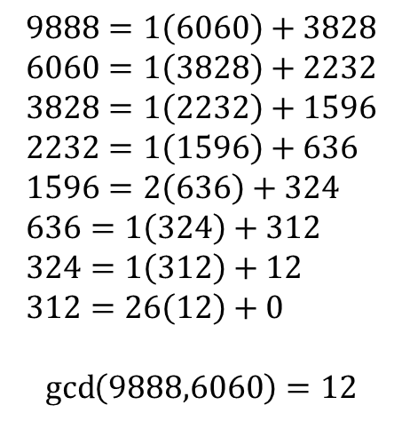
Answer – 500:
$$1331=1\left(1001\right)+330 \\ 1001=3\left(330\right)+11 \\ 330=30\left(11\right)+0$$
$$\gcd\left(1001,1331\right)=11$$
$$9888=1\left(6060\right)+3828 \\ 6060=1\left(3828\right)+2232 \\ 3828=1\left(2232\right)+1596 \\ 2232=1\left(1596\right)+636 \\ 1596=2\left(636\right)+324 \\ 636=1\left(324\right)+312 \\ 324=1\left(312\right)+12 \\ 312=26\left(12\right)+0$$
$$\gcd\left(9888,6060\right)=12$$

